Slide 1
FARGO HEALTH GROUP MANAGING THE DEMAND FOR MEDICAL EXAMINATIONS USING PREDICTIVE ANALYTICS
VIGNESHWARAN GIRI VELUMANI

Slide 2
objective
Predict the incoming cardiovascular examination volume at Abbeville HC using Time Series Analysis
Data Description
8 Year Data of Incoming Examinations from 2006-2013

Slide 3
Approach
Data Preparation
Converted Characters in ‘Incoming Examinations’ to NAs
Imputed NAs & Outliers with the Median of that particular calendar year
Validate Assumptions underlying ARIMA model
Test for normality
Test for autocorrelation
Test for stationary
Test for seasonality
Auto fit using ARIMA & Finding the Best Model
Forecast using the Best model
Analyze Residuals of the Forecast

Slide 4
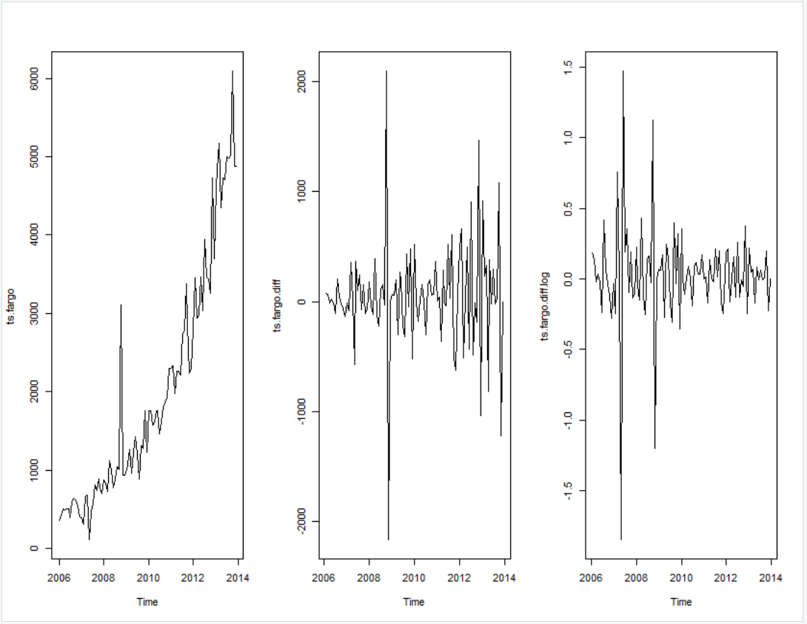
Exploratory Analysis
plot(data) plot(diff(data) plot(diff(log(data))

Slide 5
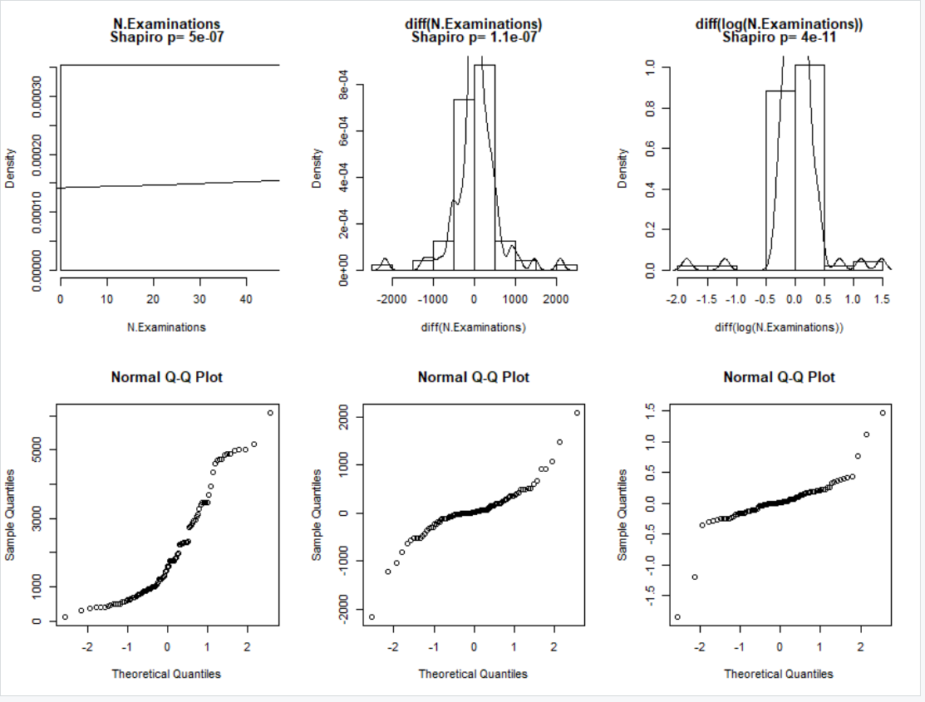
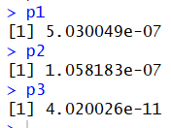
TEST for Normality – shapiro Test
Shapiro Test
From Histogram & Q-Q Plot :The diff(log(data)) is approximately normal but Shapiro Test indicates that none of the distribution is normal

Slide 6
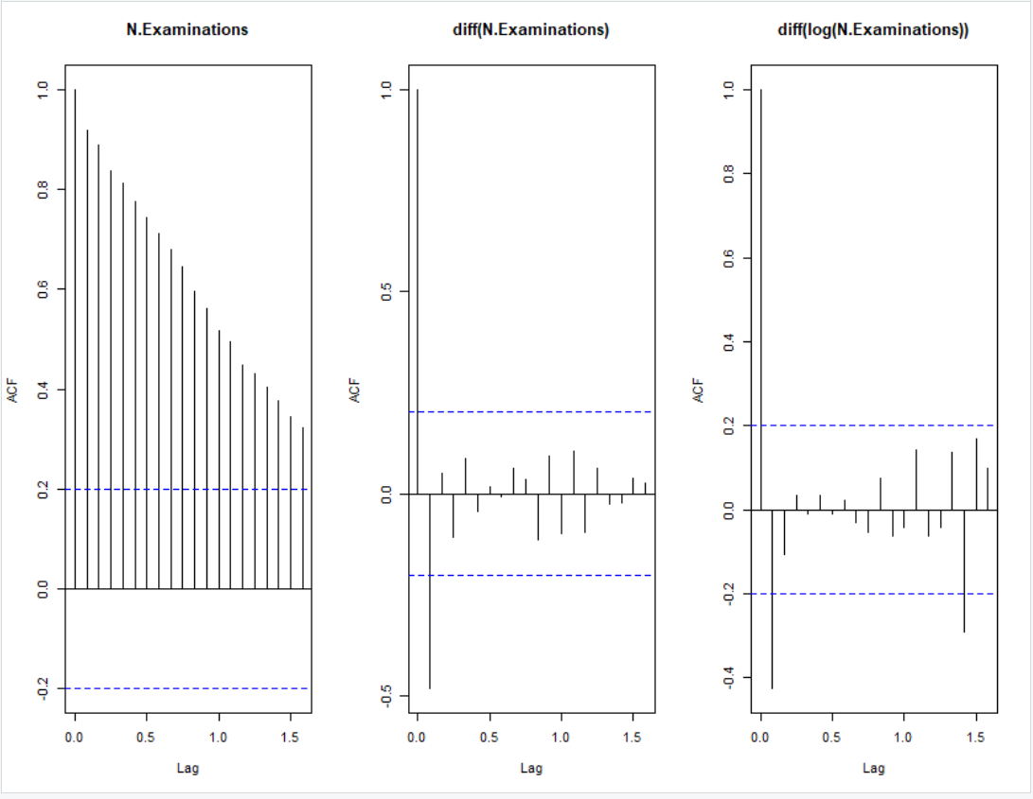
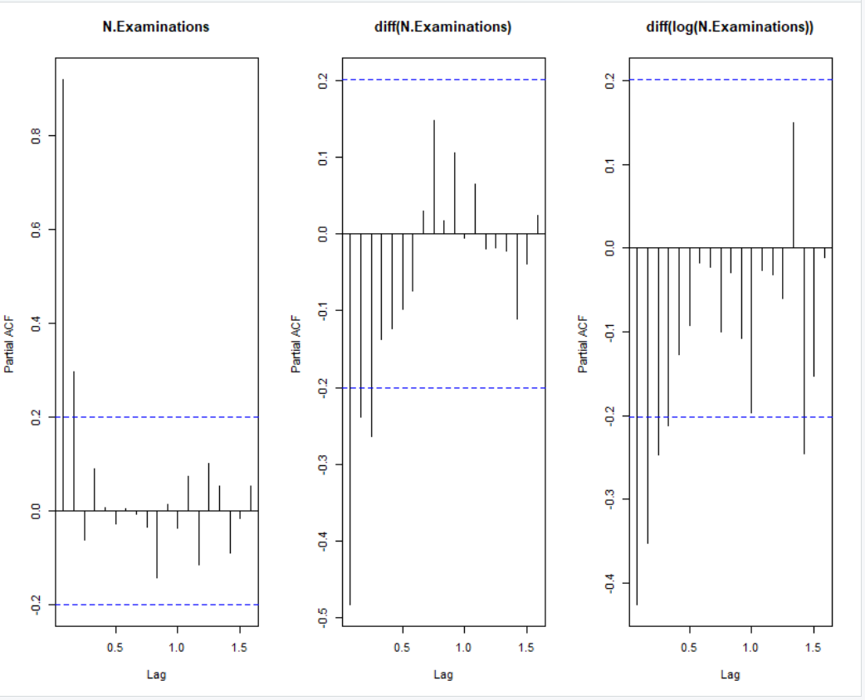
Test for autocorrelation ACF PLOT PACF PLOT
Both the diff(data) and the diff(log(data)) has an autocorrelation between period 1 and period 0

Slide 7
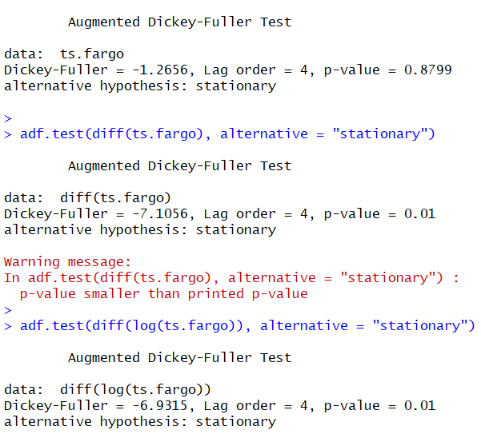
Test for Stationary - Augmented Dickey-Fuller (ADF) test
The data is a stationary time series for both diff(data) and diff(log(data))

Slide 8
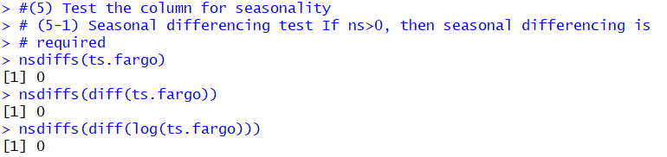
Test for Seasonality - SEASONAL Differencing test
The data does not require seasonal differencing for any of its different forms

Slide 9
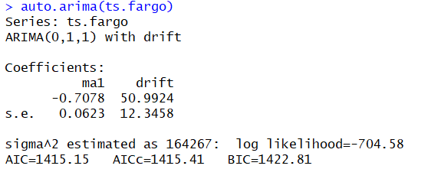
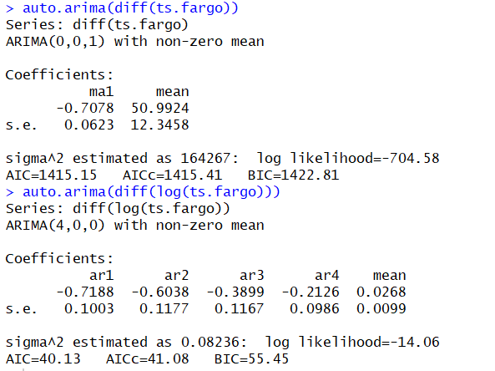
AUTO FIT USING ARIMA
We get the best fitted model (with the lowest AIC) when using the diff(log(data)

Slide 10
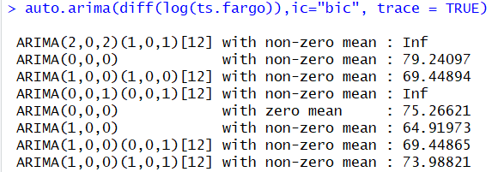
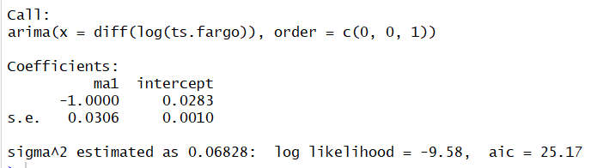
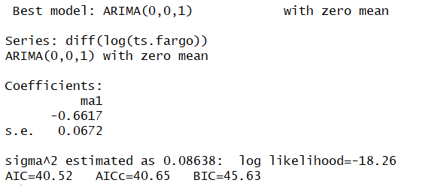
AUTO FIT USING ARIMA
Finding the best (p, d, q)

Slide 11
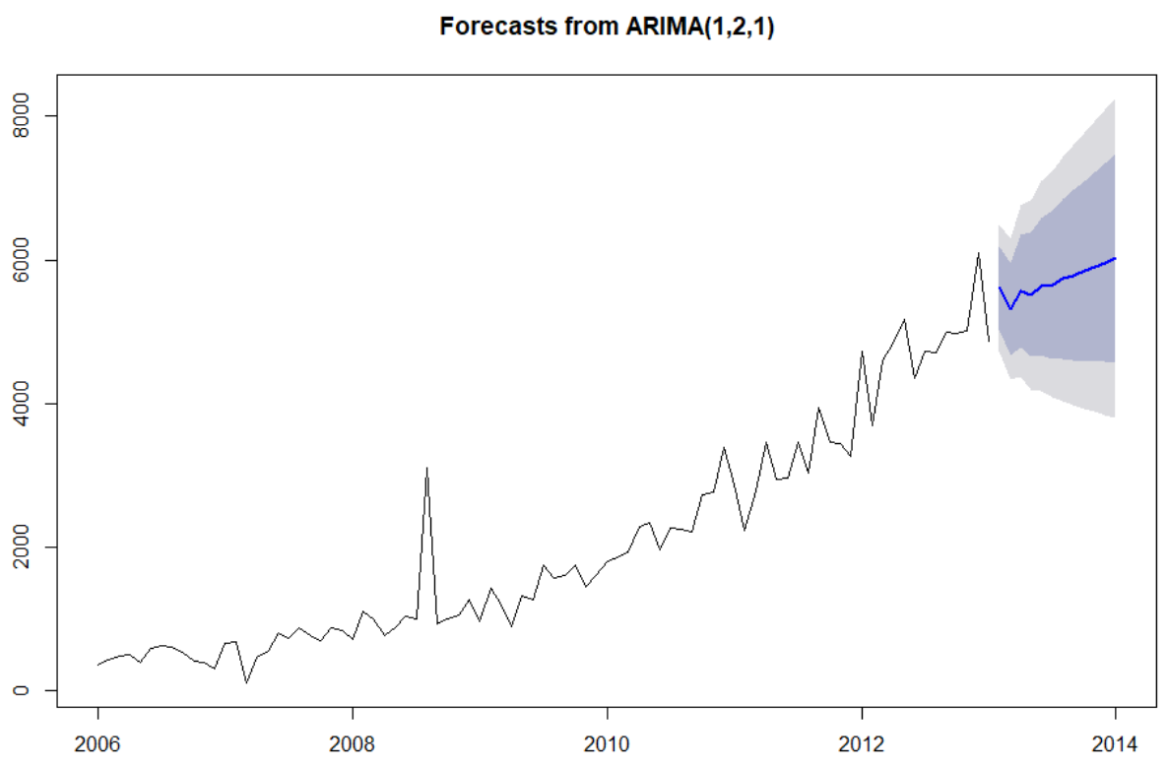
FORECASTING EXAMINATION VOLUME FOR THE NEXT 8 Years using the best model:

Slide 12
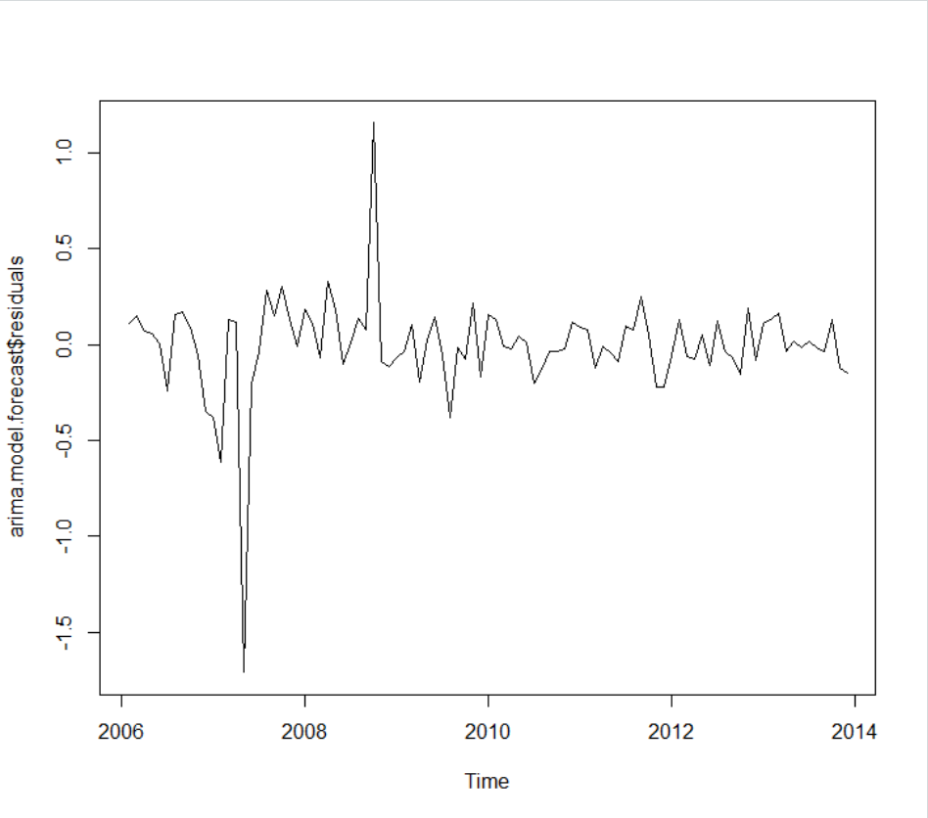
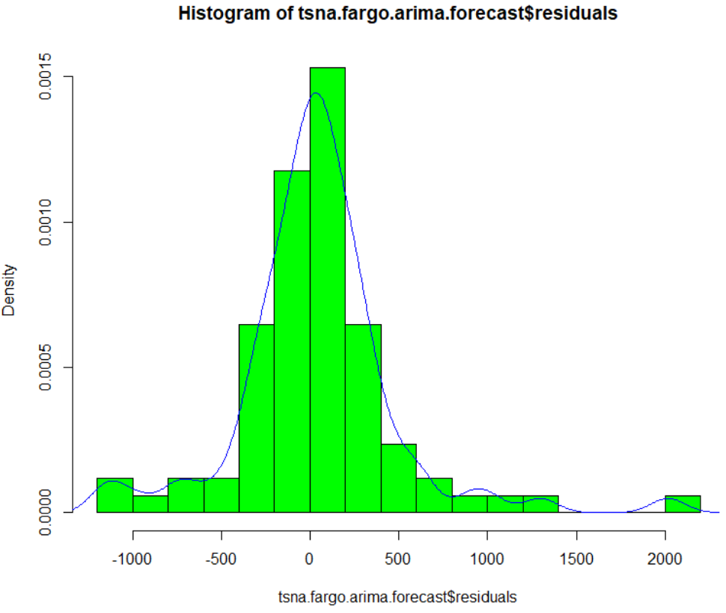
RESIDUALS OF the FORECAST distribution

